Slide 1
Week 3: 18th and 19th Century Social Movements

Slide 2
Housekeeping
Discussion topics are posted on Blackboard.
Each student should respond to 2 different discussion leaders.
Forums close every Monday at 9am.
Assignment #2 due 9/19, posted on Blackboard

Slide 3
Review: Responding to Social Problems
What are social movements?
Collective, organized, sustained attempts at social change which last over time (i.e. “campaigns”) and feature “WUNC” displays
Not individual efforts or single protest events
Inherently antagonistic and engaged with a powerful opponent
These opponents can be the nation-state, political institutions, the economy, and other societal institutions and organizations
But they can also be more abstract: ideological, cultural, social norms

Slide 4
WUNC displays:
Worthiness - expressions or symbols which personify the dignity of the claimants or oppressed group, usually accomplished through the presence of children, mothers, clergy or other “respectable” people
Unity - tangible expressions of collective identity such as banners, chants, songs, or other things which match
Numbers - Measures, statistics, photos, etc which show how large the campaign is
Commitment - Demonstrated through enduring challenging conditions, be they physical, atmospheric, environmental, etc.

Slide 5
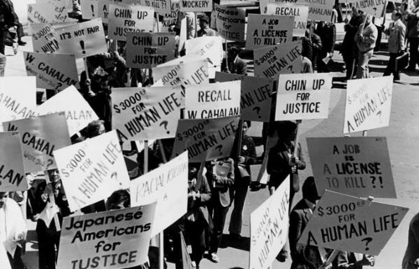
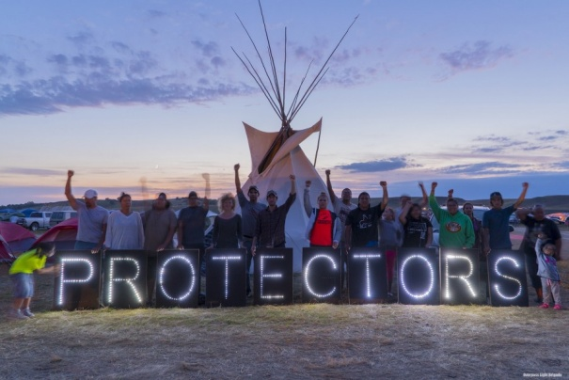
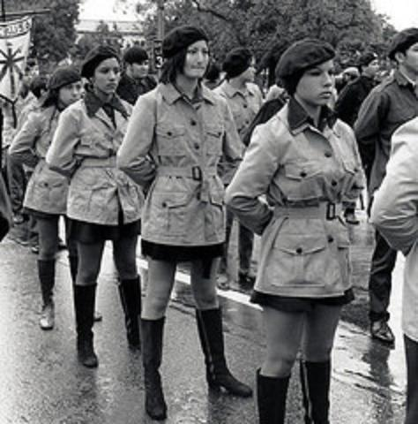
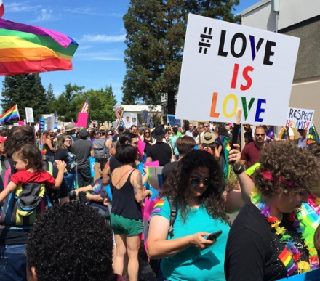
Name the Movement Via Their WUNC Displays?

Slide 6
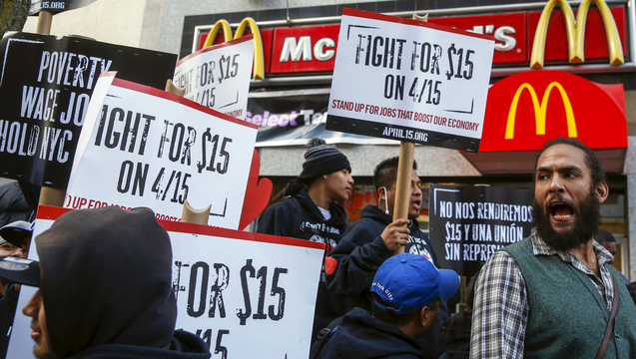
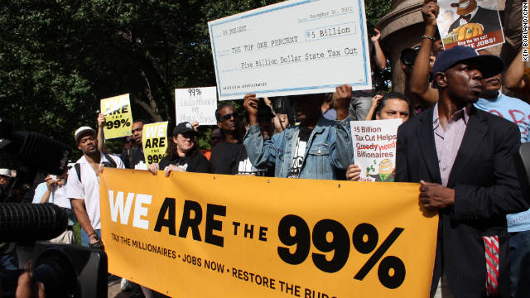
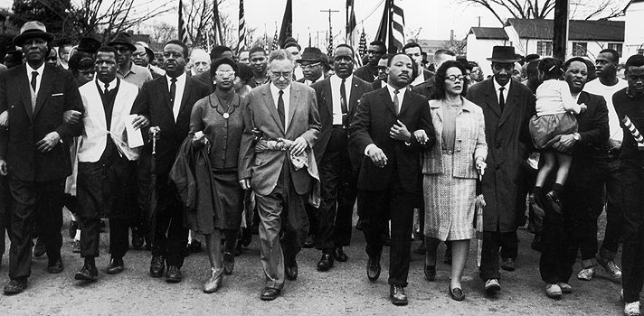
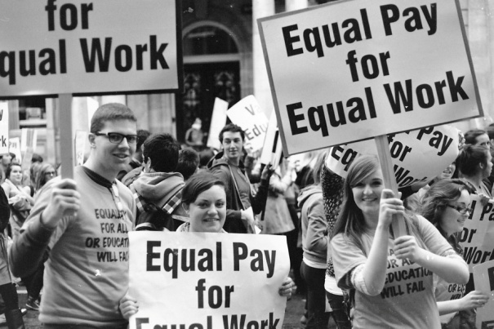
Name the Movement, cont.

Slide 7
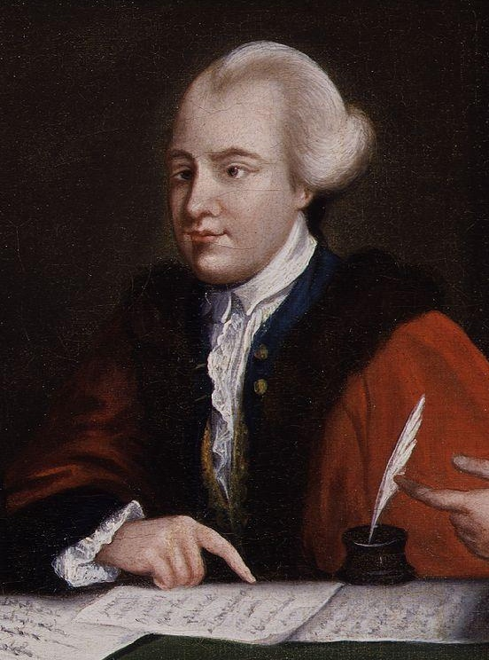
Social Movements in Britain
Tilly and Wood focus their discussion on the “invention” of social movements by focusing primarily on London, France, and Belgium in the 1700 and 1800s.
They look at the public displays of resistance in support of political figure, John Wilkes during the 1760s.
Wilkes’ effort to become the mayor of London as well as join the British Parliament led to the formation of organizations and the eventual connection between group-based political action and appeal to legislative authority.

Slide 8
Social Movements in Britain, cont.
The radical campaign to elect Wilkes was often violent and pushed directly against the “proper” British protocol for public politics:
British citizens could legally meet in guilds, communities, and religious groups and had legally protected rights to do so.
Representatives from these groups could state grievances and make demands and had the right to be heard by local authorities.
Anyone who assembles publicly and/or makes demands outside these boundaries is breaking the law and subject to harsh and often violent punishment, especially if such grievances are directed at the ruling class.

Slide 9
Macro Level Influence on the Wilkes Campaign
What were the social, political, and economic factors which made these earlier forms of British collective action possible?
Seven Years’/French and Indian War between England and France (1756-1763).
In England, the war and increased reliance on a legislature to govern Britain’s colonies led to regular citizens having more direct contact with their government.
In the North American colonies, increases in land, wealth, and power via imperialism led to a larger, often oppressed workforce with more direct connections to each other than their employers, creditors, or the crown.

Slide 10
Social, political, and economic factors which made these earlier forms of British collective action possible, cont.
England won the war, but at great financial cost; they imposed taxes and other harsh financial conditions on their colonies.
Unfair financial and labor conditions in combination with a growing sense of collective grievance led to the formation of organizations in both England the North American colonies, which gave space for demands to be heard and resistance to be strategized.
These types of collective spaces where grievances against oppression monarchies could be heard eventually lead to both the American and French revolutions in the 1780s.
If we move ahead 100 years, we begin to see exponential growth in the number of associations, groups, etc. in Europe and the United States. What kinds of groups were these? What brought on their proliferation?

Slide 11
But what is missing from Tilly and Wood’s narrative? What is implied and implicitly described, but not addressed directly?

Slide 12
The Invention of Social Movements: Macro Level Factors
But what is missing from Tilly and Wood’s narrative? What is implied and implicitly described, but not addressed directly?
Video 1: https://www.youtube.com/watch?v=YazVFIuQudc
Video 2: https://www.youtube.com/watch?v=alJaltUmrGo

Slide 13
The Invention of Social Movements: Macro Level Factors, cont.
If we look at social movements outside of Europe and the U.S., we get a more complete picture about the “invention” of social movements.
Particularly notions of nationalism, the importance of culture, and ethnic identity can be examined when we look at movements that developed in response to Europe and the U.S. (next week).

Slide 14
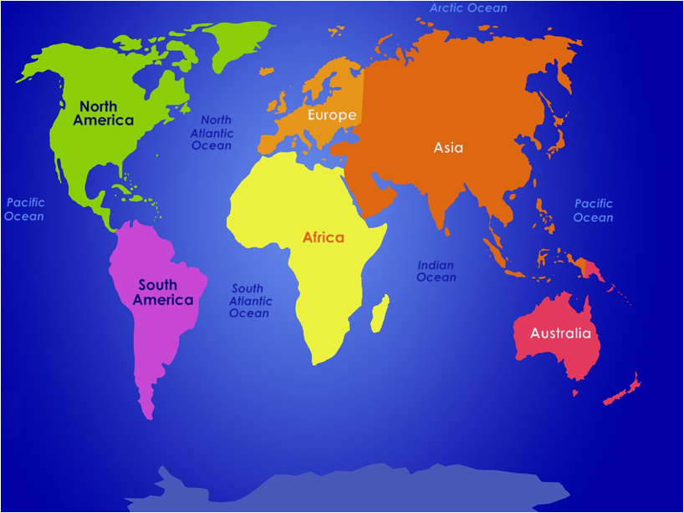
Social movements in India in the 1700 and 1800s show the importance of local histories, collective injury vs. individualistic capitalist pursuit, and peasants’ resistance to landlords and British rule

Slide 15
Social movements in Latin America, staring in the early 1800s, featured indigenous peasants who resisted Iberian colonialism, expansion of haciendas into native lands, racist divisions of labor, and dismissal of native cultures

Slide 16
Social movements throughout the Middle East and North Africa resisted Napoleon’s conquest of Egypt, France’s military genocide of Algeria and Morocco, and Iranian resistance to European tobacco companies in the 1800s

Slide 17
Social movements in Australia took 2 forms in the late 1700s and 1800s: aboriginals who resisted British colonialism and sought to preserve their culture and British prisoners who rebelled against the oppressive penal conditions.

Slide 18
The Invention of Social Movements: Macro Level Factors, cont.
Therefore, we can say that the history of social movements in the modern world (1700s - forward) is primarily resistance to European imperialism (outside of Britain) or to the monarchy in England.

Slide 19
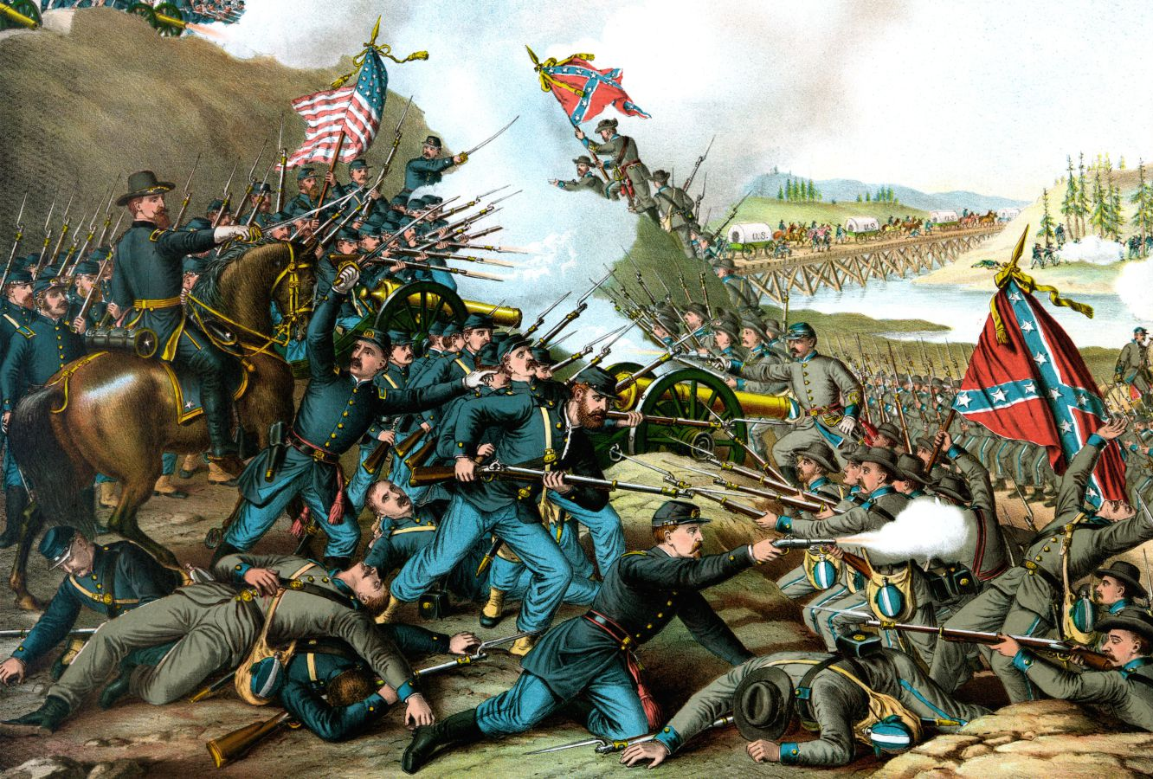
The Social Movement that Lead to the Deadliest War in U.S. History
There is one social movement, spanning both the 18th and 19th centuries which lead to the deadliest war in U.S. history: abolition.
The Civil War between the north and the south over the institution of slavery lead to the death of nearly 1,000,000 million people (1861-1865).

Slide 20
Abolition
Starting in the 1730s and lasting until the House passed the 13th Amendment on January 31, 1865, the abolitionist movement had 2 components:
Northern abolitionists who led large anti-slavery organizations who sought to dismantle the system.
Southern slaves who were looking for individual freedom.
These 2 systems influenced each other, with the southern movement pushing the northern movement further to the left.

Slide 21
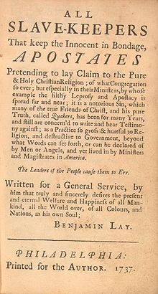
Abolition, cont.
Northern organizations got their start in the 1730s with the Quakers, who thought that abolition would be a gradual and peaceful process that would preserve the financial wealth of white slave-owners.

Slide 22
Abolition, cont.
Quakers debate over slavery - https://www.youtube.com/watch?v=wfUvdgEyYy0
Tukufu Zuberi on Quaker values and enslavement - https://www.youtube.com/watch?v=XoG02Q2x13I

Slide 23
Abolition, cont.
To Zuberi’s point, there were no black people in Quaker anti-slavery societies.
Even though the rhetoric of the early abolitionist movement centered on the natural rights of human beings, these were not viewed as equal rights for blacks.
That is, Quakers viewed enslaved blacks as human and therefore deserving of freedom, but NOT as equal to whites.
Also, much of the work of these early organizations did not occur in the south, where the majority of slaves resided.

Slide 24
Abolition, cont.
This demonstrated that benevolence was not enough to bring about justice and equality.
Rather, it would take multiple macro and meso level factors to put pressure on the federal government to abolish slavery:
The creation of northern black organizations and institutions to put pressure on the slavery system
Religious revivalism that focused on stamping out public sin
Several southern slave revolts

Slide 25
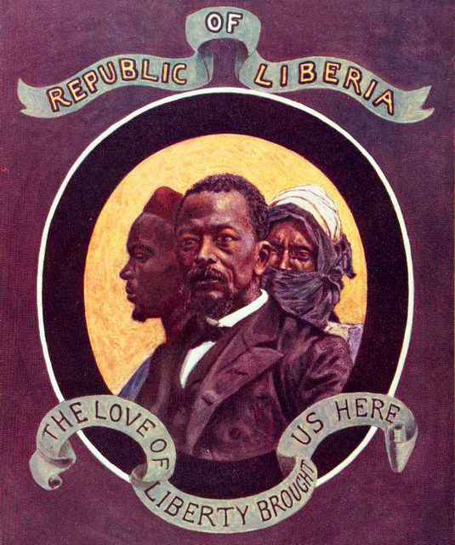
Abolition, cont.
Besides northern African American temperance and anti-slavery societies, the other major organizational force that impacted the abolitionist movement was the American Colonization Society (1817).
The goal of this organization was to resettle enslaved people in the British colony of Freetown, Sierra Leone and the U.S. colony Monrovia, Liberia.

Slide 26
Abolition, cont.
History of Liberia - https://www.youtube.com/watch?v=-iXzyPw1WbA

Slide 27
Abolition, cont.
However, this approach differed along racial lines. Black nationalists such as Paul Cuffe, Prince Hall, and Alexander Crummell wanted to go because they felt that they would never be treated as equal citizens in the U.S.
Whites who founded ACS wanted to exile the free black population because they believed that too many free blacks would create an uncontrollably dangerous population.
In fact, many of these people thought that slavery was the only way to civilize and control black people and, if they weren’t going to be enslaved, then they needed to be done away with.

Slide 28
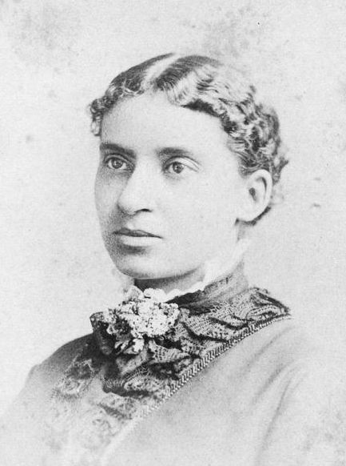
Abolition, cont.
Religious revivalism, known as the Second Great Awakening, sparked the founding of numerous black “temperance” societies, which urged women to be proper mothers and wives and men to stay away from alcohol and gambling.
In fact, in her farewell speech, black feminist abolitionist Maria Stewart chided black men in Boston for their lack of temperance and said that those energies were better spent in service of the cause (1833).
She also criticizes the ACS’ approach to liberation.

Slide 29
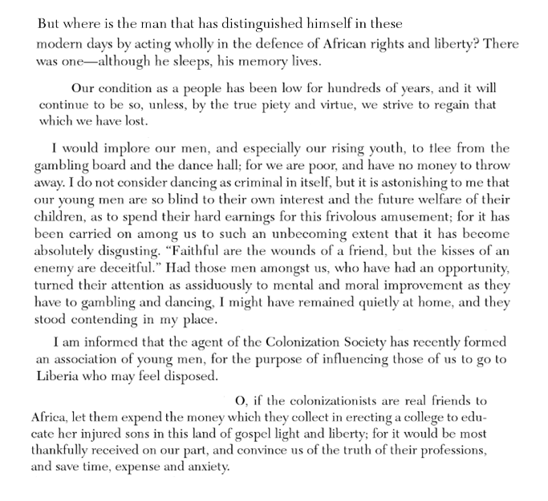
Abolition, cont.

Slide 30
Abolition, cont.
The final macro level issue that impacted the direction of the abolitionist movement were slave revolts, most notably the Haitian Revolution (1791-1804) and Nat Turner’s revolt (1831).
When news of the Revolution and Nat Turner’s revolt spread across the American south, some enslaved people were no longer content to wait on the benevolence of the Quakers and their gradual approach or risk escape in order to travel to Liberia.
They wanted freedom and they were emboldened by the bravery of the Haitians and Turner as well as the rebellions planned (but never carried out) by Gabriel Prosser in Virginia (1800) and Denmark Vesey in South Carolina (1822; Mother Emmanuel Church).

Slide 31
Abolition, cont.
Nat Turner 1 - https://www.youtube.com/watch?v=ZrRBGGVTM38
Nat Turner 2 - https://www.youtube.com/watch?v=9SobJftnGJU
Haitian Revolution - https://www.youtube.com/watch?v=b69lS3aP1a4
Note: Other macro factors are Texas admission as a slave holding state in 1845; Mexico is forced to cede California and New Mexico to the U.S.; those terrorities are declared as non-slave holding states in the Compromise of 1850; as a result the Fugitive Slave Act is passed and it stiffens penalties against people who run away from bondage.

